Slide 1
Lung transplantation without frontiers
György Lang, MD, PhD
VIENNA-BUDAPEST LUNG TRANSPLANT PROGRAM
(Director: Prof. Walter Klepetko, MD)
MEDIZINISCHE UNIVERSITÄT WIEN
KLINISCHE ABTEILUNG FÜR THORAXCHIRURGIE
SEMMELWEIS EGYETEM MELLKASSEBÉSZETI KLINIKA AZ
ORSZÁGOS ONKOLÓGIAI INTÉZET BÁZISÁN, BUDAPEST

Slide 2
Lung transplantations MUW 1989-2015
(primary LuTX: n=1597, ReTX: n=140)

Slide 3
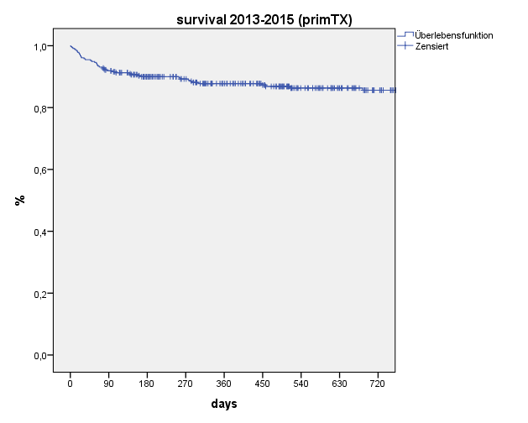
Survival 2013-2015 (prim TX) (n=330)
1 year survival 88%

Slide 4
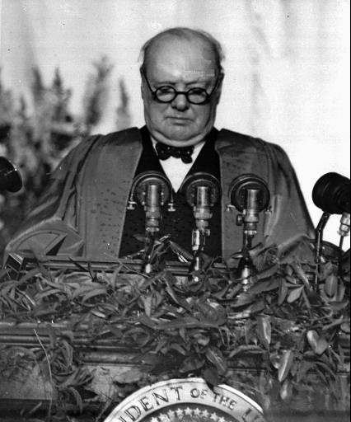
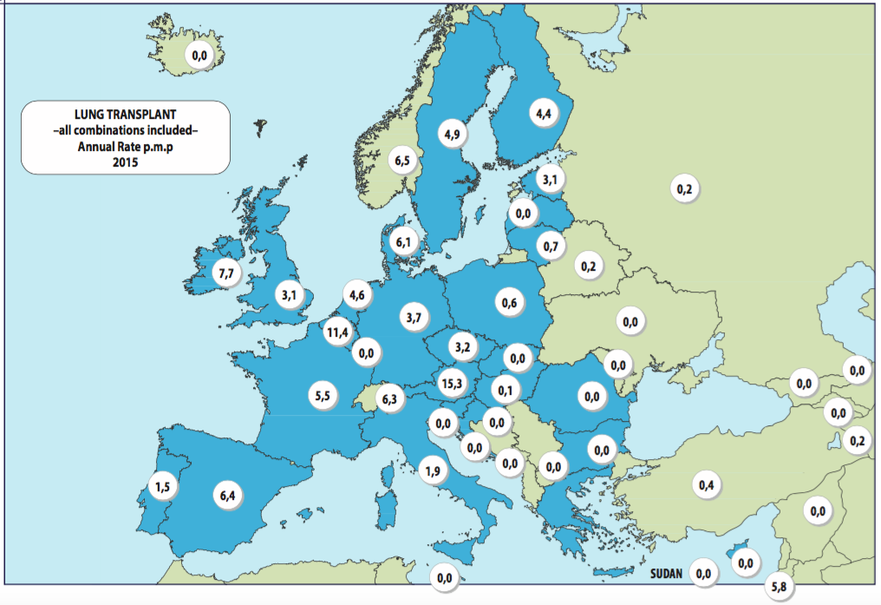

The Iron Curtain of Lung Transplantation
From Stettin in the Baltic to Trieste in the Adriatic,
an Iron Curtain has descended across the continent.”
Winston Churchill, March 5, 1946, Westminster College, Fulton, Missouri

Slide 5
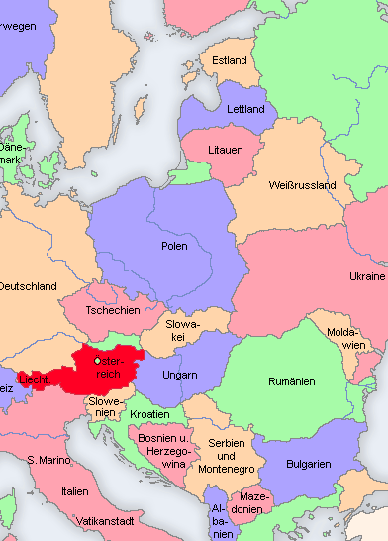
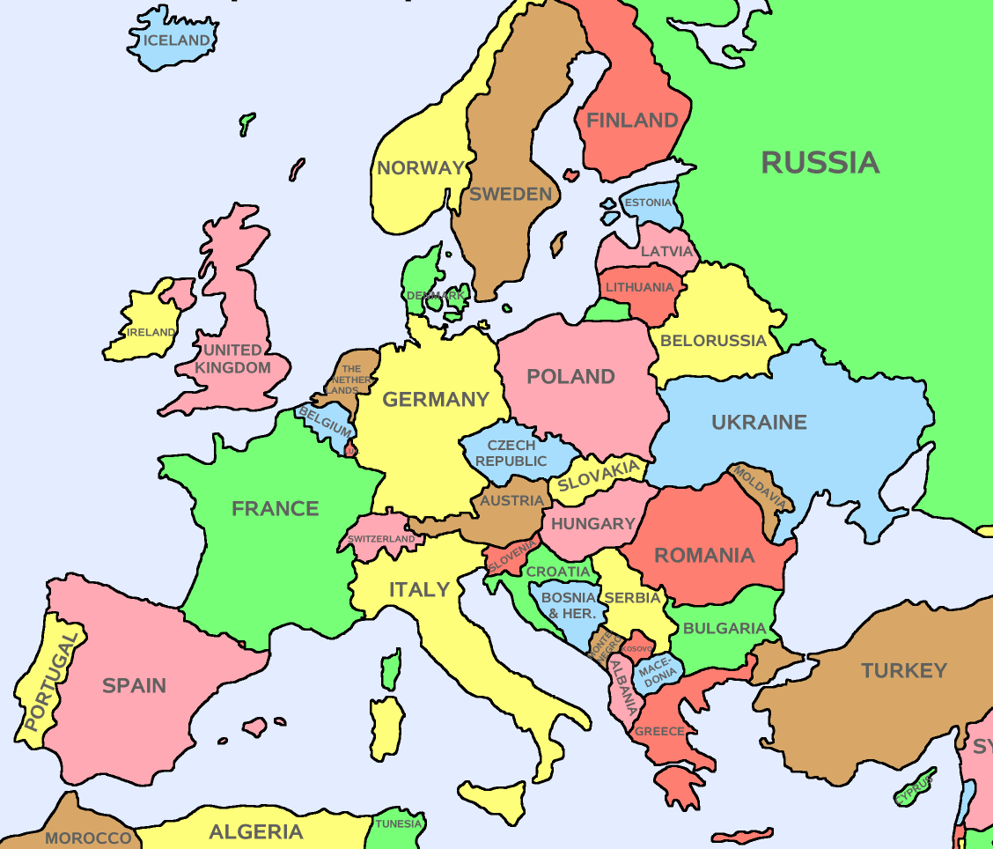
Vienna:
Special geographic, logistic and historic position
2010
1997
1997
1998
2002
2001
1997
2002
2003

Slide 6
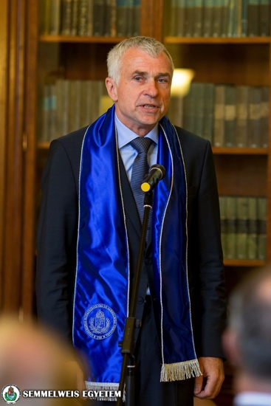
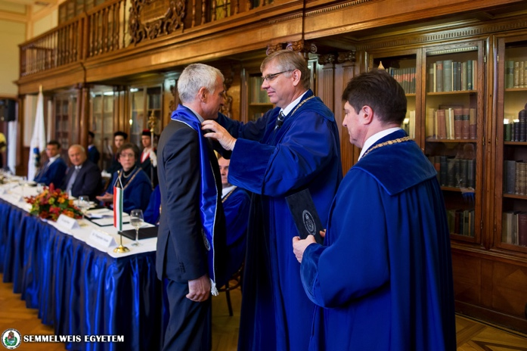
Prof. Dr. Walter Klepetko
Semmelweis University Budapest
Doctor Honoris Causa
11th November 2016

Slide 7
Goal of cooperations / twinnings
  Make LuTX available to patients
  Make unused organs available for TX
  3. Systematic training of local physicians (modules)
    Evaluation
    Follow-up
    Procurement
    Transplantation

Slide 8
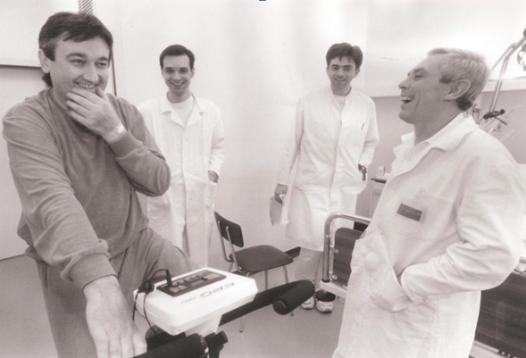
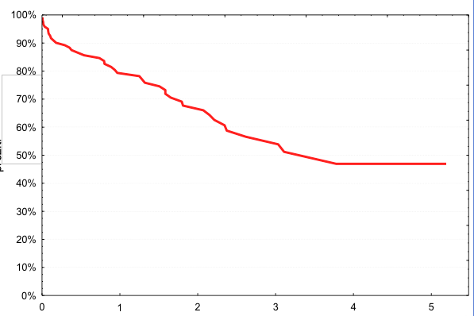
The start of regional cooperations: Czech Republic
1994: Prof. Pavel Pafko visiting Vienna
1994 - 1997: Twinning period
1997 - today: Independent Czech LuTx program

Slide 9
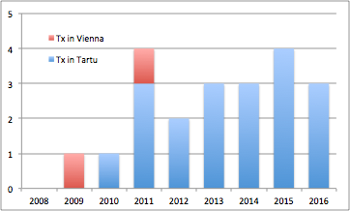
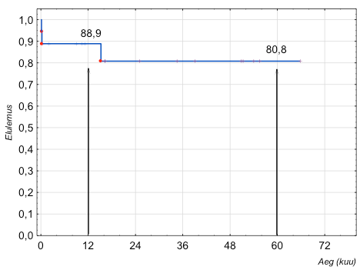
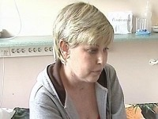
Estonia
2008: Prof. Pavel Tanel Laisaar visiting Vienna
2008-2011: Twinning period
2012 - today: Independent Estonian LuTx program
Walter Klepetko M.D.

Slide 10
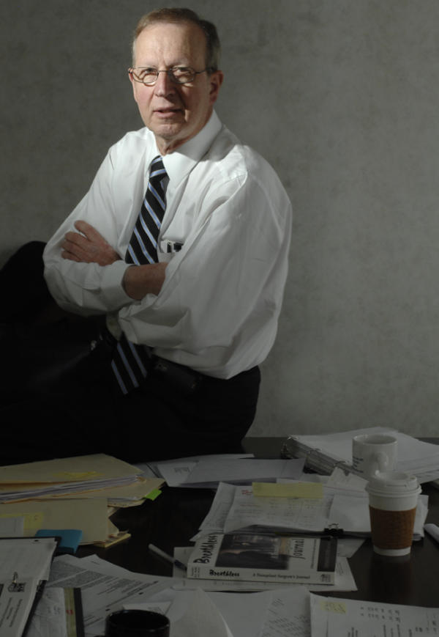
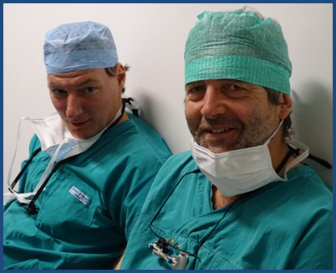
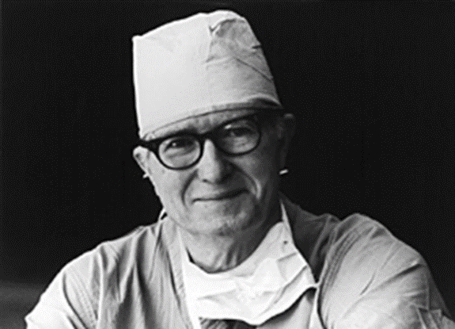
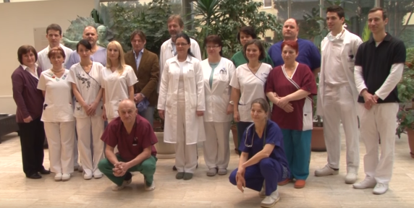
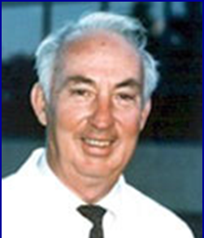
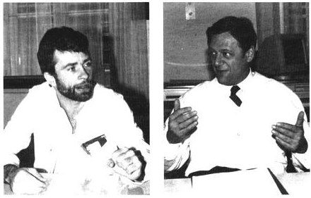



Historical note
1963.06.11.
1983.
1986.
1996.
2015.12.12.
1981.
1989.11.08.
.

Slide 11
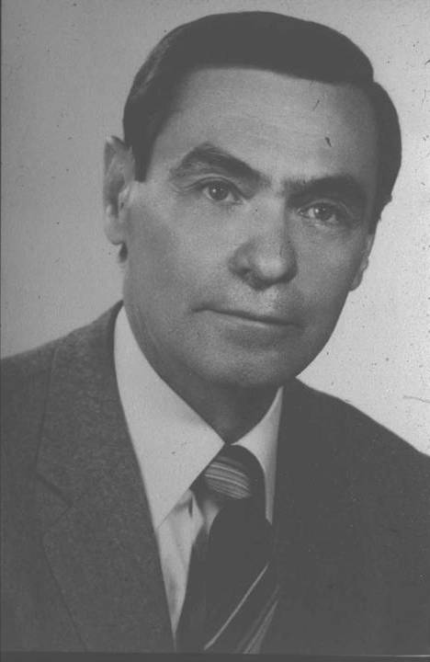
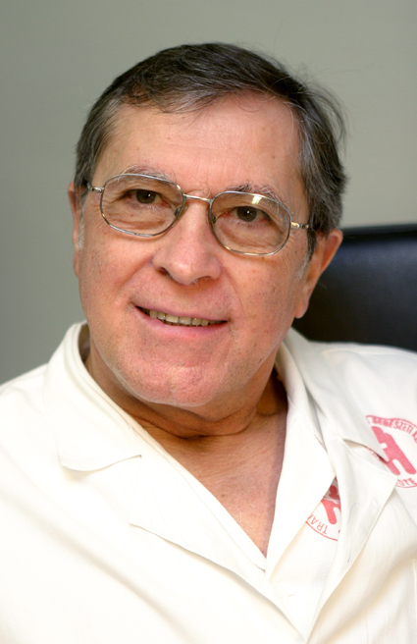
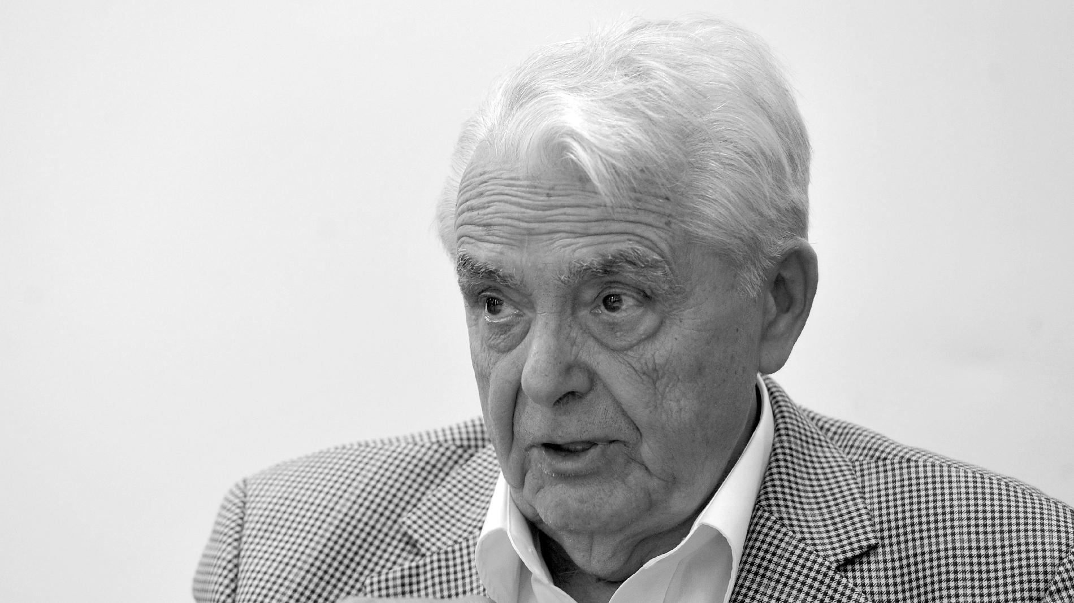
Start of different solid organ TX programs worldwide and in Hungary
1962
1973, 1985
1992
Hungary
International

Slide 12
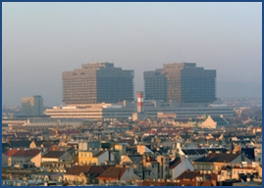
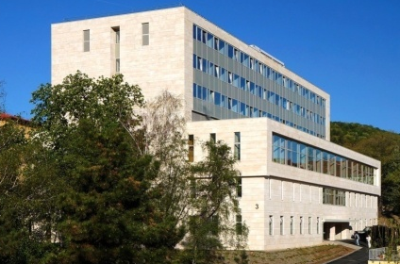
First Hungarian patient transplanted in Vienna: 1996.03.05.
20 years / 180 patients
First LuTX in Hungary: 2015.12.12.
Eger, 2016. november 24.
.
Notes:
Első magyar Bécsben 27 éves férfi fibrosis miatt
Első magyar Budaesten 54 éves férfi COPD miatt

Slide 13
First TX or TX Program ???
Goal | First | Program
Background | Single person | Team
Driving force | Ambition | Institution / Government
Approach | Individual | Systematic
Environment | Surgical | Multidisciplinary
Goal | Short-term outcome | Long term results
Benchmark | Time (asap) | Quality
Network | Local | International
Strategy | Start with surgery | Surgery last step
Quality control | ?? | Approved SOP

Slide 14
4 steps to build a LuTX Program
          Organ donation
          Follow up
          Evaluation / Selection
          Local transplantation

Slide 15
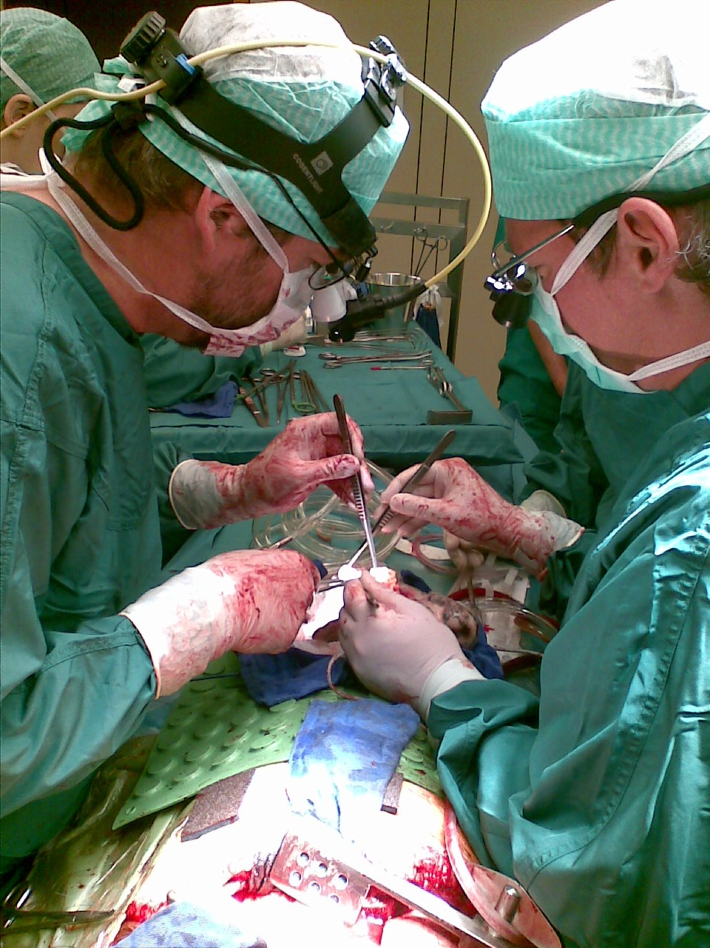
Normal Ward /Follow Up
Evaluation
ICU
TX
Procurement
2005
2003/2008
2002

Slide 16
Time outline twinning period Vienna-Budapest
2007: OVSZ SZKI
First Hungarian patient transplanted in Vienna
2013: Hungary joins Eurotransplant
2004: EU membership

Slide 17
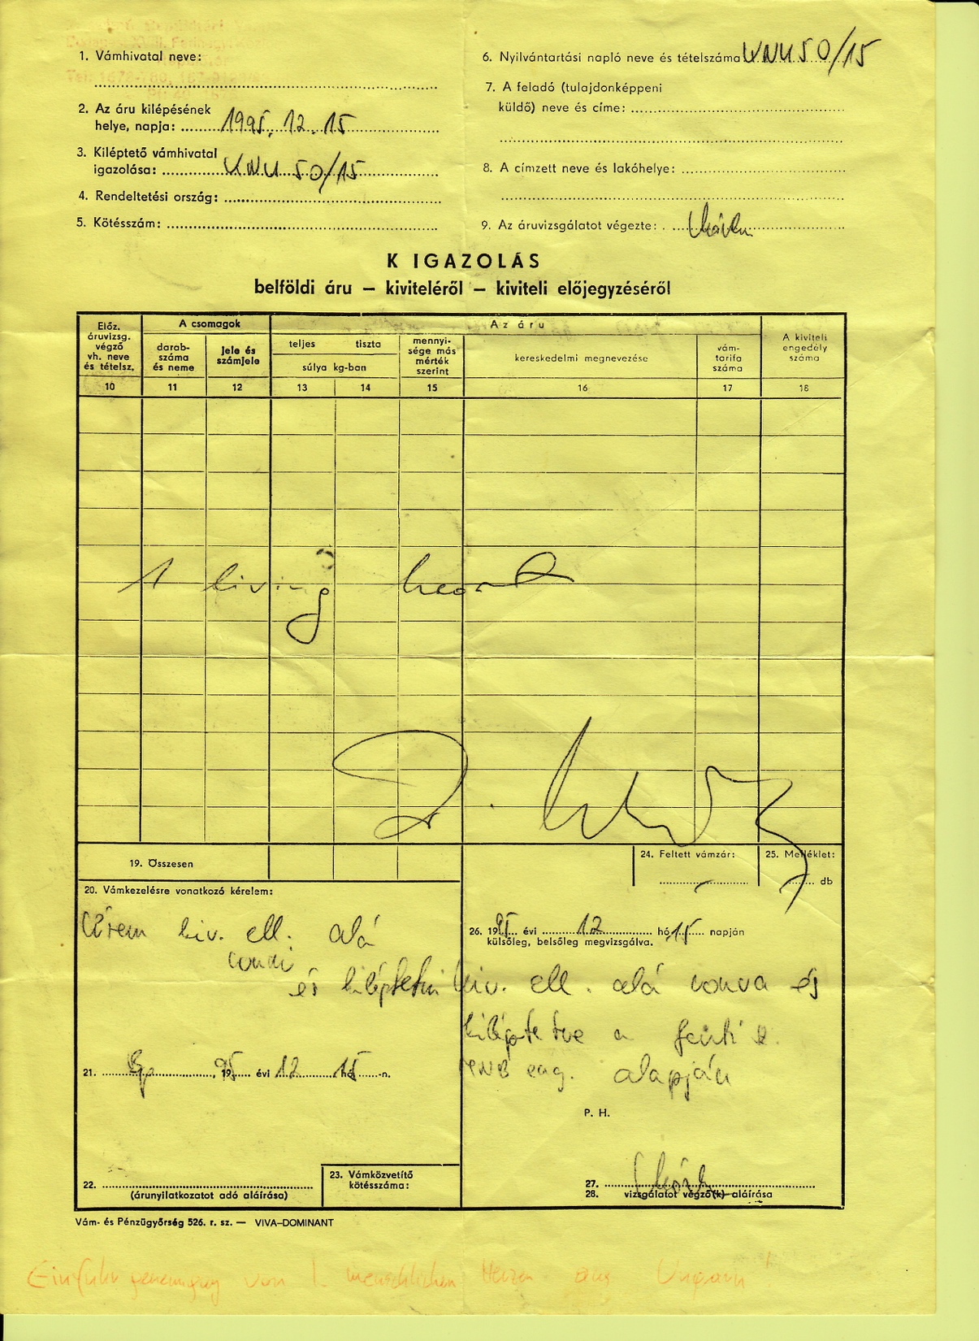

Slide 18
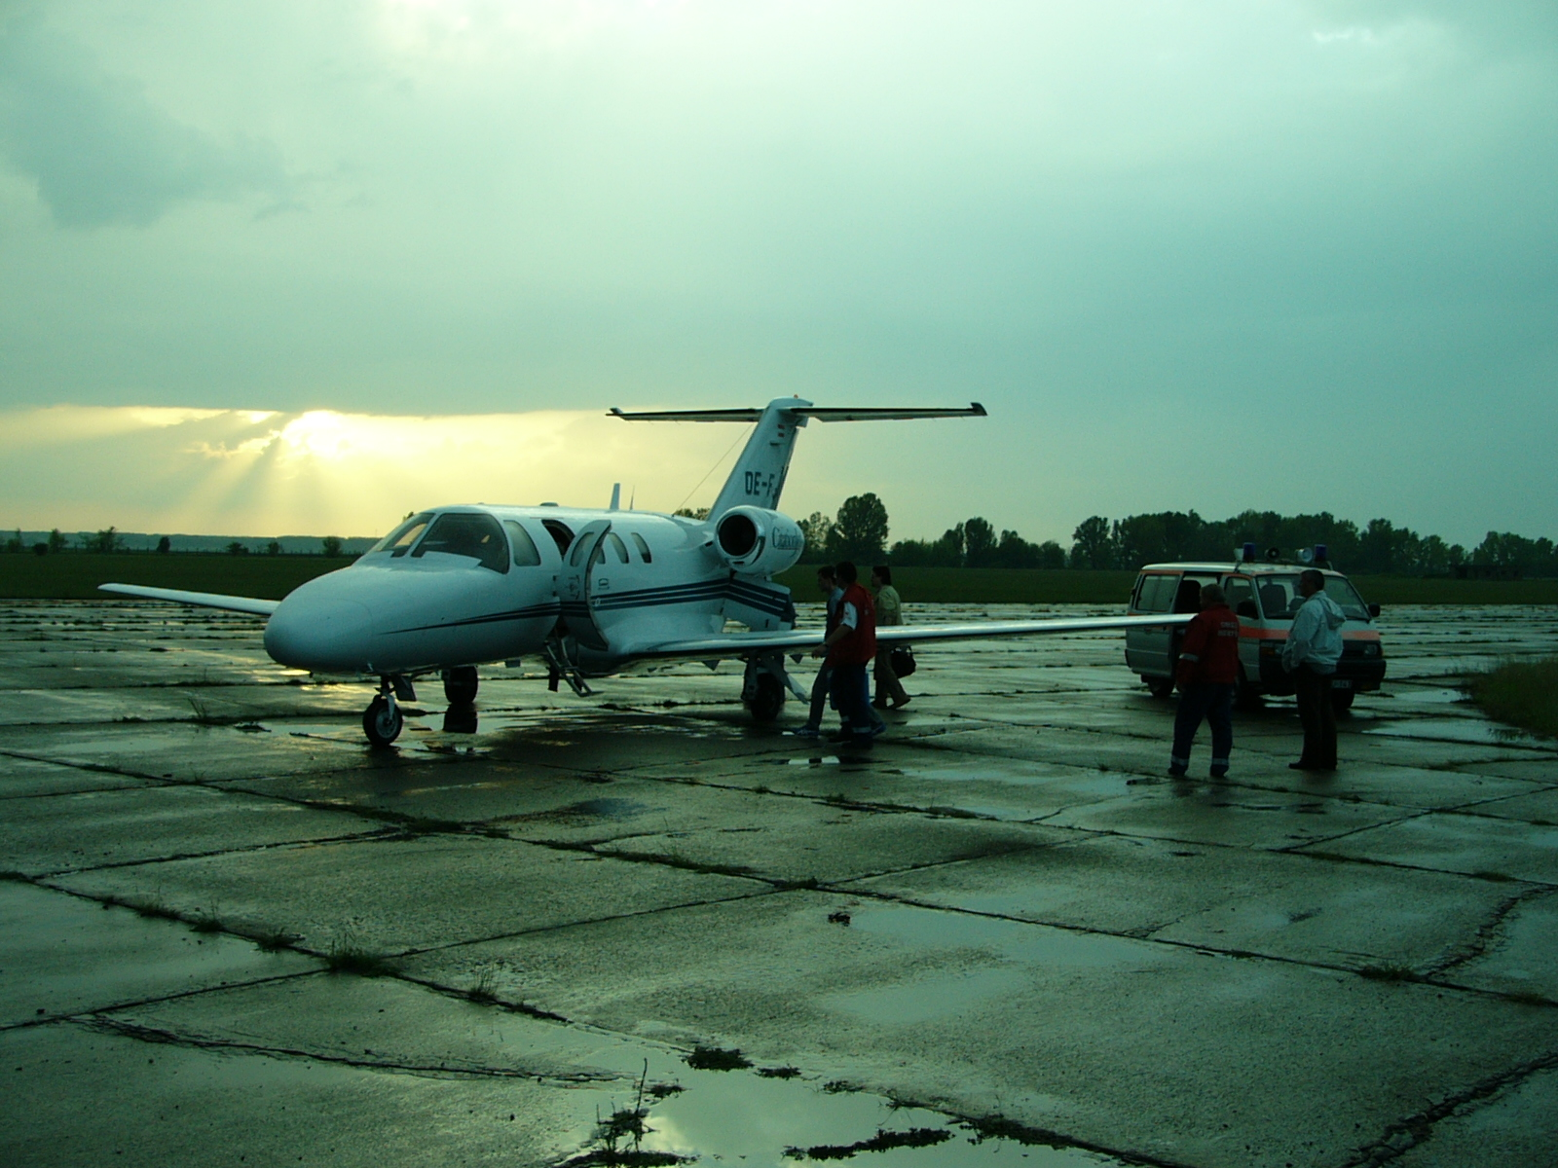
1th May 2004, Kalocsa:
First lung procurement in Hungary whithout customs and border controll...

Slide 19

Organ donor and tx coordination network
National Coordinators (6)
Procurement coordinators (9)
Hospital coordinators (20)
In 20 hospitals
Clinical Coordinators (14)
In 6 tx centres
Organ Coordination Office
Central organization
Competent Authority
Donor side coordination
Recipient side coordination
Transplant Centers
Donor side coordination
Donor Centers
www.hnbts.hu/oco

Slide 20
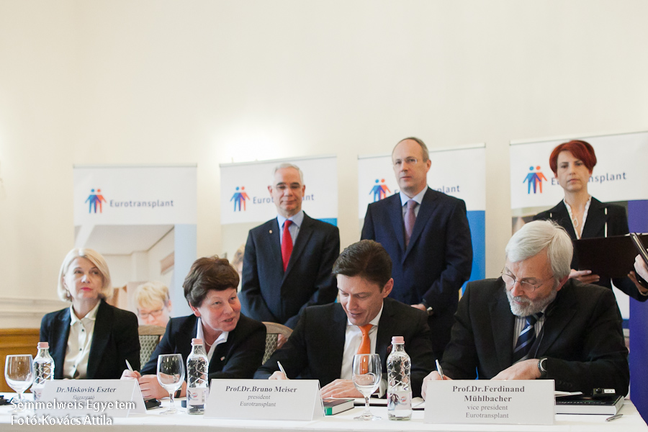
Eurotransplant contract 2013

Slide 21
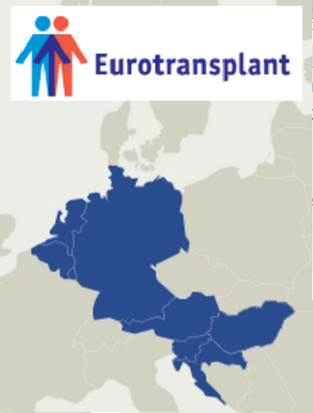
Eurotransplant membership
.

Slide 22
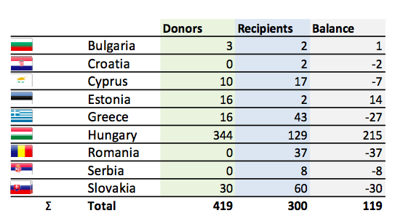
Non-ET Twinnings/Cooperations
(2000-2015)

Slide 23
Non-ET Twinnings/Cooperations
Organ balances 2016
 | Recipients transplanted | Organs received
BUL | 7 | 14
GRE | 3 | 7
ROM | 3 | 10
SLK | 5 | 1
+7
+4
+7
-4
18 32
Balance: +16
Additionally received from Twinnings/Cooperations:
2 hearts
Several livers
15
11
2
3

Slide 24
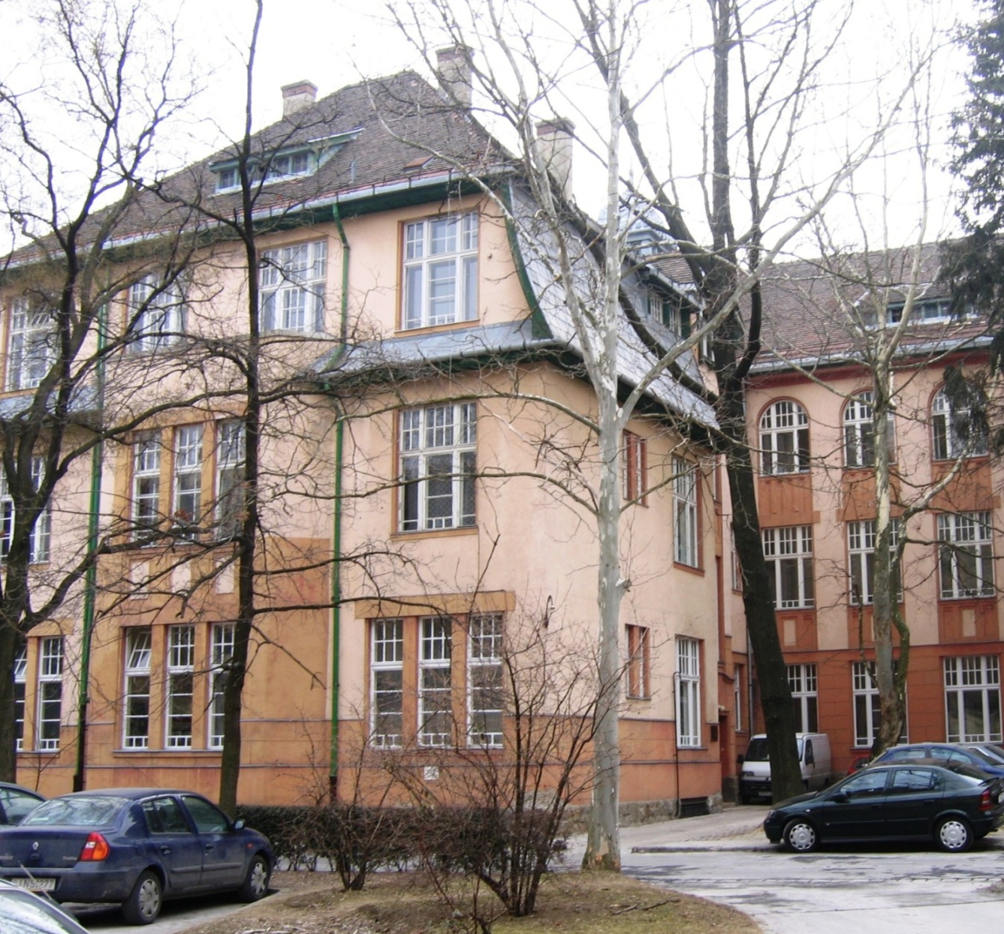
LuTX Board
Semmelweis University, Dept. Of Pulmonology
Decision making: 2 pulmonogists, 1 TX surgeon
Monthly / according to need
LTX cost absorbtion dependent from board decision (central switch position)
Case discussions open for interested specialists
Eger, 2016. november 24.
.

Slide 25

Hungary (n=152)
Age: 35.2± 15.0 (7.3-65.1) ys

Slide 26


Austria (n=949)
Age: 49.2 13.9 (0.6-72.2)ys

Slide 27
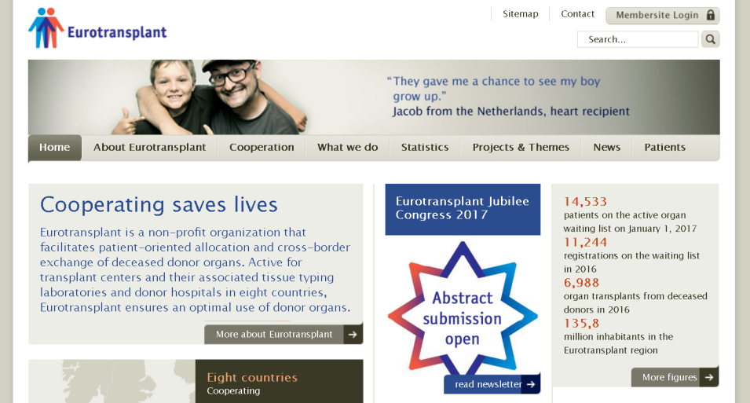
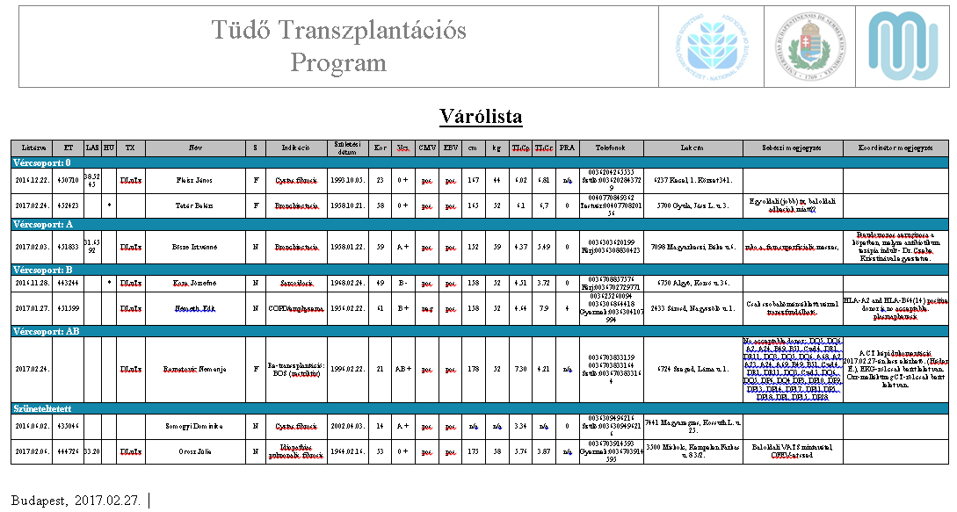
Waiting list management
Registration
National Board
Evaluation
Listing
https://www.lutx.hu
.

Slide 28
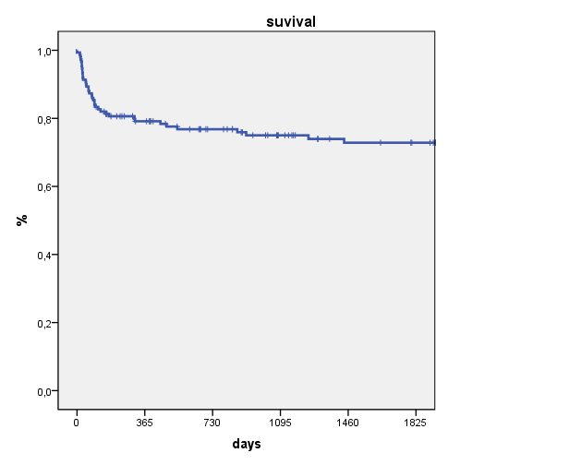
Follow up
Semmelweis University, Dept. Of Pulmonology
Semmelweis University, 1st. Clinic for Pediatrics
Outpatient
Ward
Rehabilitation
Eger, 2016. november 24.

Slide 29
LuTX case and patient number 2008-2015
Department of Pulmonology Semmelweis University

Slide 30
Bronchoscopic procedures in 2015
Department of Pulmonology Semmelweis University

Slide 31
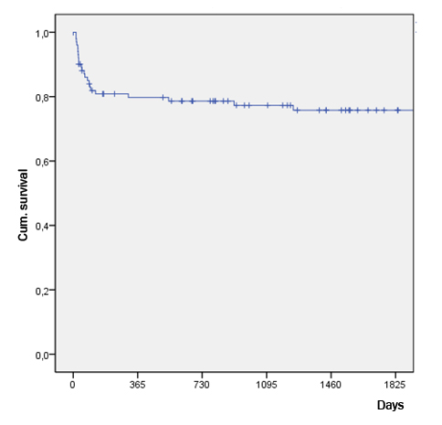
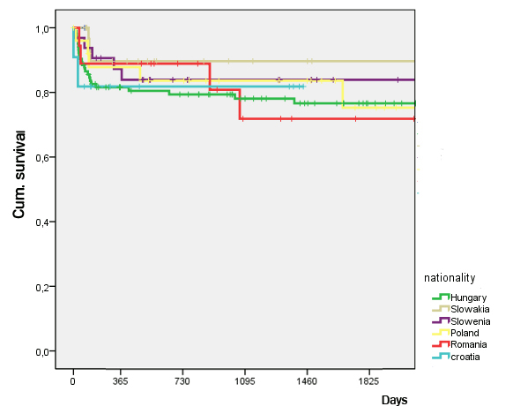
Centralised TX - Regionalized Follow Up
Does it work?
Overall survival
Country specific survival

Slide 32
2013
2013
Normal Ward /Follow Up
Evaluation
ICU
TX
Procurement
2005
2003/2008
2002

Slide 33


10th January 2013
Consensus meeting (all stakeholders), initiated by the Ministry of Health
Center definition (Budapest, affiliation to Semmelweis University)
Legislative background (Permission, ET contract)
Reimbursement issues (Evaluation, TX, Follow-up)
Infrastructure Investment
Eger, 2016. november 24.
.

Slide 34
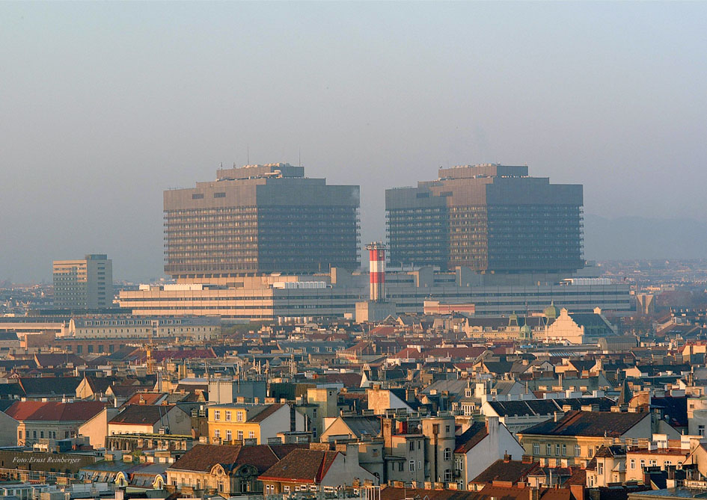
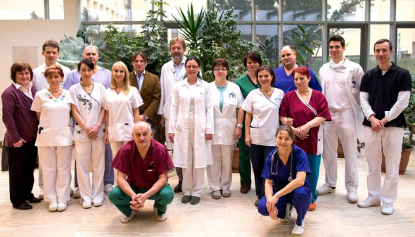
Arrangements in Budapest since 1/2013
Team
Procurement surgeons 2
Transplant surgeons 2
Transplant pulmologist 3
Pathologist 1
Physiotherapy 2
Anaesthesia / ICU 4
Coordinators 2
Scrub nurses 2
Psychologist 2

Slide 35
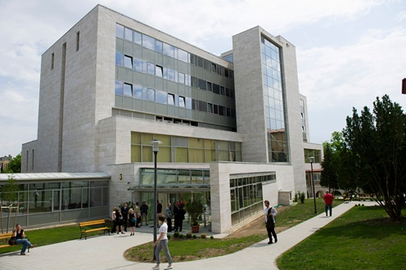
Infrastucture
2012
Department of Thoracic Surgery / NIO:
  1200 thoracic procedures / year
  Modern and dedicated ICU team (Dr. Jenő Elek)
2014
Department of Thoracic Surgery, Semmelweis University
  University affiliation
  Running “modules” (evaluation, procurement, follow-up)
  Twinning partner of MUW/AKH
2015
3.000.000,- € Investment
  Upgrade OR, ICU, ECMO, BSK, CT)
Eger, 2016. november 24.
.

Slide 36
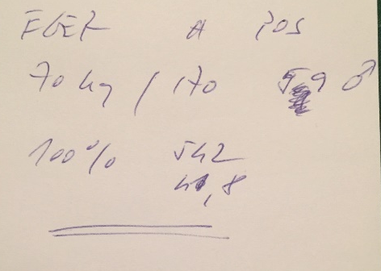
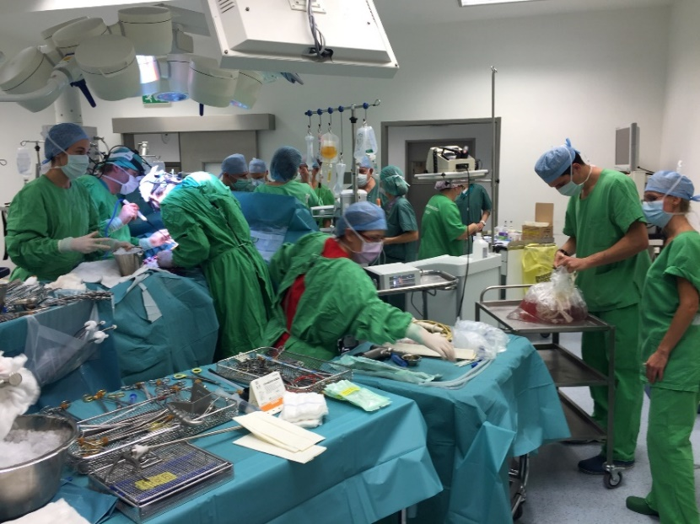
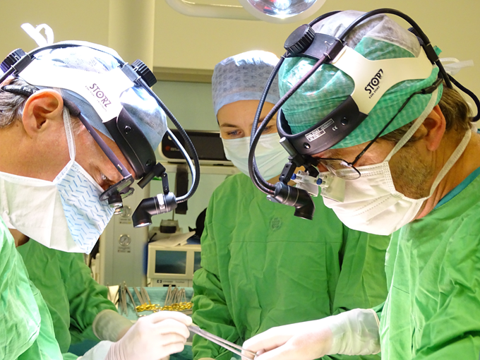
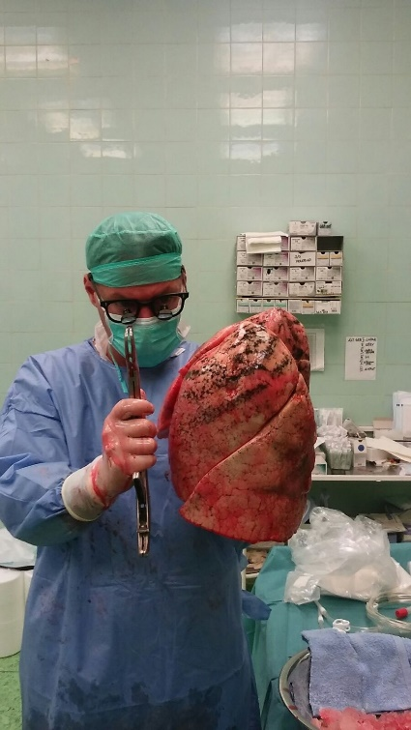
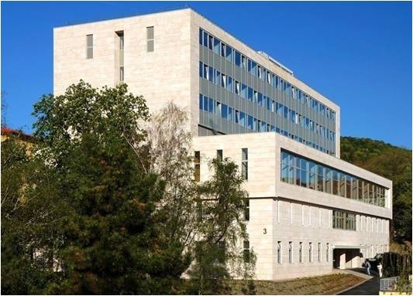
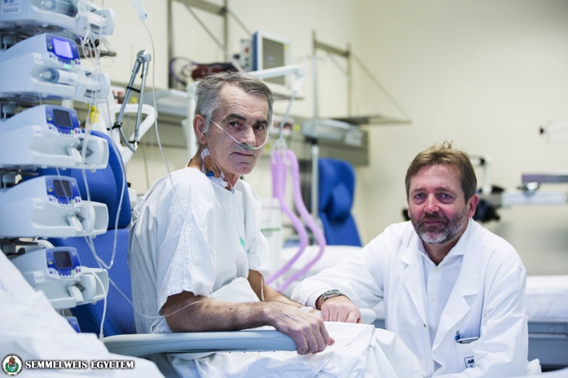
2015.12.12. – First LuTX in Hungary

Slide 37
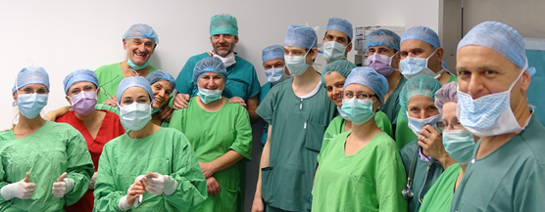
The Team

Slide 38
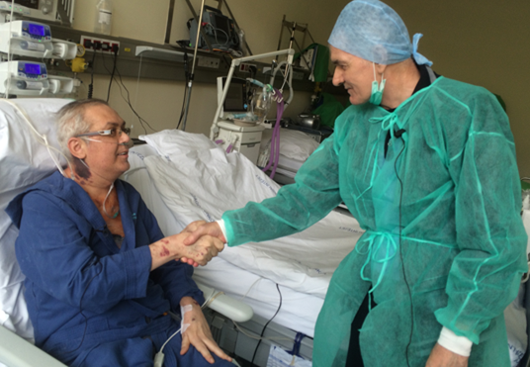
The first and the second patient...
Eger, 2016. november 24.

Slide 39
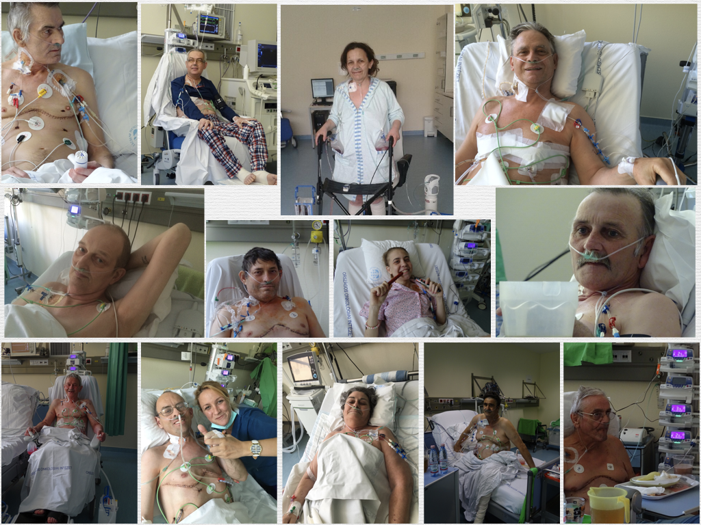
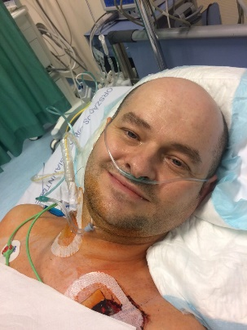
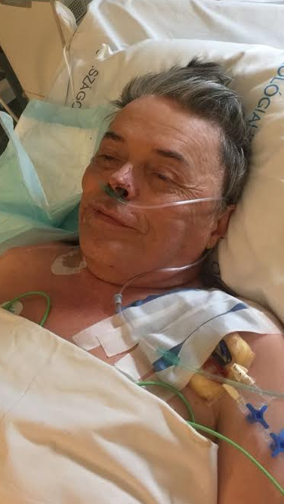
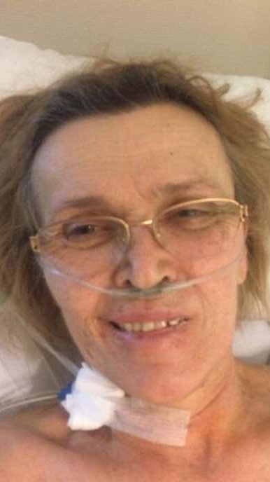
And many others ☺

Slide 40
LuTx Vienna LuTx Budapest
Status 28.9.2017

Slide 41
LuTX procedures (2015.12.12 – 2017.09.28.)
Alapbetegség | LuTx Bécs (n=8) | LuTx Budapest (n=36)
Felnőtt
COPD | 0 | 17
IPF | 1 | 6
IPF / ECMO bridge | 0 | 1
CF | 0 | 6
CF / Tüdő - Vese Tx | 0 | 1
CF / Tüdő - Máj Tx | 1 | 0
PH | 2 | 1
PH / ECMO bridge | 1 | 0
Hystiocytosis | 0 | 1
Brochiectasia | 0 | 2
LAM | 0 | 1
Gyermek
CF | 1 | 0
CF / ECMO bridge | 1 | 0
PH / ECMO bridge | 1 | 0
.

Slide 42





Slide 43






CIT:
405 MINS
6,75 HOURS

Slide 44







Procurement sites (n=31, 2015.12.12-2017.03.12)
16/13
7/5
4/3
1/1
1/1
1/1

Slide 45


Allocation
Center allocation
Common donor pool
Decision makink according to
  Medical issues
  Risk profile recipient
  Local capacities
  Logistics

Slide 46
Current status of twinning programs
Partner | Organ Donation | Follow Up | Evaluation | TX
Czech Republik |  |  |  | 1997
Estonia |  |  |  | 2009
Hungary |  |  |  | 2015
Slovenia |  |  |  | 2018
Croatia |  |  |  | 2019 ??
Greece |  |  |  | 2019-2020 ???
Romania
Bulgaria
Cyprus

Slide 47
Waitlist data as per 31th Dec 2016
 | ET waitlist (134 million citizens) | Estimated need in Hungary (9.9 million citizens) | Hungarian waitlist | Level (%)
Kidney | 10901 | 804 | 739 | 91,9%
Liver | 1704 | 126 | 111 | 88,3%
Heart | 1130 | 83 | 40 | 48,0%
Lung | 797 | 59 | 9 | 15,3%
Pancreas | 449 | 33 | 11 | 33,2%

Slide 48
Conclusion
High need to develope new LuTX programs in Eastern Europe
Systematic and stepwise approach to avoid frustrating learning curves
Twinning aggreements or equivalent cooperations provide the necessary logistic background

Slide 49




Thanks for your kind attention....
György Lang, MD, PhD
SEMMELWEIS UNIVERSITY BUDAPEST
DEPARTMENT OF THORACIC SURGERY
VIENNA MEDICAL UNIVERSITY
DEPARTMENT OF SURGERY
DIVISION OF THORACIC SURGERY
Notes:
49

Slide 50

Team Vienna:
Walter Klepetko
Peter Jaksch
Gabriella Muraközy
Christopher Lambers
Clemens Aigner
Bernhard Moser
Shahrokh Taghavi
Jose Matilla Sigüenza
Beate Smeritschnig
Mir Ali Reza Hoda
Thomas Klikovits
Stefan Schwarz
And many others....
Team Budapest:
Ferenc Rényi-Vámos
Balázs Gieszer
Peter Radeczky
Jenő Elek
Ildikó Madurka
Nóra Schönauer
Krisztina Czebe
György Losoncz
Veronika Müller
Zoltán Süttő
Anikó Bohács
Zsuzsanna Kováts
And many others too...

